Slide 1
COMPRESSIONS,
BENDING
AND TORSION UNDER PLASTIC CONDITIONS
By Dr. Andoh

Slide 2
Introduction
This unit discusses the bending moment and torsion required to form a plastic hinge and also the distribution along a beam at a collapse load.

Slide 3
Learning Objectives
After reading this unit you should be able to:
Calculate the bending moment required to form a plastic hinge for any particular cross-section,
Determine the distribution of bending moment along the beam at the collapse load.
Compute the shape factor for each type of cross-section
Calculate the torque required to form a plastic hinge for a circular section

Slide 4
MOMENT UNDER PLASTIC CONDITION
In the elastic theory of bending, the method of design has been to calculate the maximum stresses occurring, and to keep them within the limits of working stresses in tension and compression, the working stresses being obtained by dividing the yield (or ultimate) stress by a factor of safety. However, mild-steel structures do not fail as soon as the edge stress at any cross-section reaches the yield point, and will continue to withstand the load as long as a central core of the section remains in the elastic state.

Slide 5
In any particular loaded beam, if the load system were increased gradually, yielding would first occur at the extreme fibres of the" weakest" section (if the material exhibits a drop in stress at yield, the lower yield stress is taken to apply). These fibres are then said to be in the plastic state, and further increase in loading will bring about a considerable increase in strain (and hence deflection) at that section of the beam, with a redistribution of stress. With mild steel this increase in strain can take place without the stress rising above the yield point (i.e. strain hardening effects can be neglected, the plastic strain at yield being of the order 10/20 times the elastic strain), so that the stress in the plastic region may be assumed constant.

Slide 6
When the whole cross section at any point in a structure becomes plastic, no further increase in the moment of resistance is possible without excessive strain (equivalent to an increase in curvature at that section) and a plastic hinge has been developed.
Depending on the type of structure (e.g. simply supported beam, built-in beam, rigid frame, etc.) one or more plastic hinges are required to cause complete collapse. The value of the load to produce this state is called the collapse load, and the ratio collapse load: working load is called the load factor.
In plastic design this factor is used to replace the normal factor of safety.

Slide 7
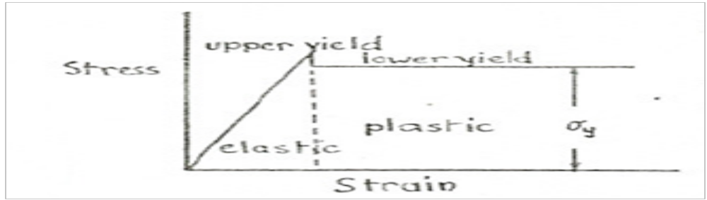
Assumptions in the Plastic Theory
The material exhibits a marked yield, and can undergo considerable strain at yield without further increase in stress. This limits application of the theory generally to mild steels, and as there is a drop in stress at yield the lower yield stress is used in calculations. Below shows the idealized stress-strain diagram for such a material.

Slide 8
The yield stress is the same in tension and compression.
Transverse cross-sections remain plane, so that strain is proportional to the distance from the neutral axis, though in the plastic region stress will be constant, and not proportional to strain.
When a plastic hinge has developed at any cross-section the moment of resistance at that point remains constant until collapse of the whole structure takes place due to the formation of the required number of further plastic hinges at other points.

Slide 9
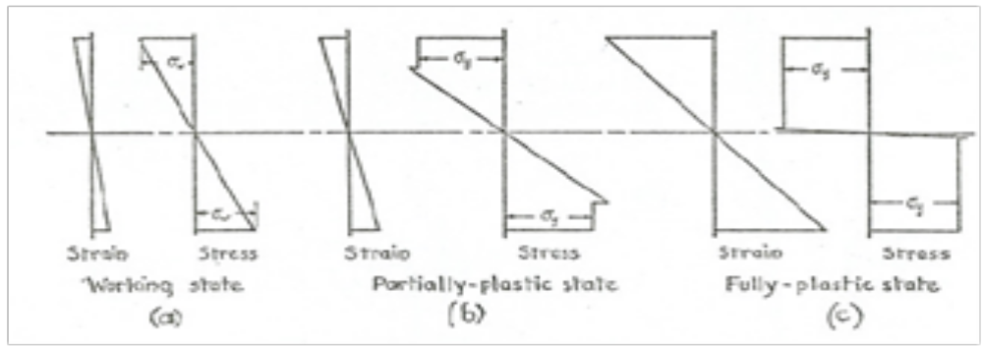
Moment of Resistance at the Plastic Hinges
The figure (a) below shows the variation of stress and strain in a symmetrical cross-section under the working load, by the simple theory of bending, (σ_{w} is the maximum working stress).

Slide 10
If the load is increased until yielding occurs in the extreme fibres the partially plastic state of Figure (b) would be obtained, where σ is the lower yield stress (note how the assumptions are applied).

Slide 11
Further increase in load produces the fully plastic state of Figure (c), in which the stress is assumed uniform and equal to σ_{y}. There will still be a very small elastic region around the neutral axis, as indicated in the diagram, but the effect of this on the value of the moment of resistance is very small and will be neglected

Slide 12
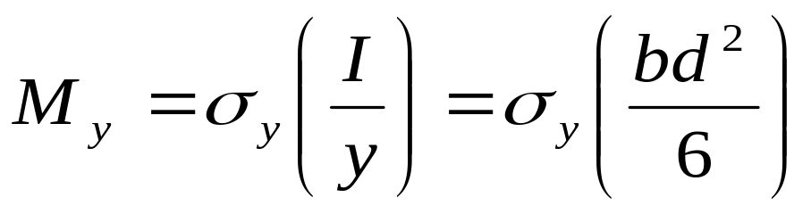
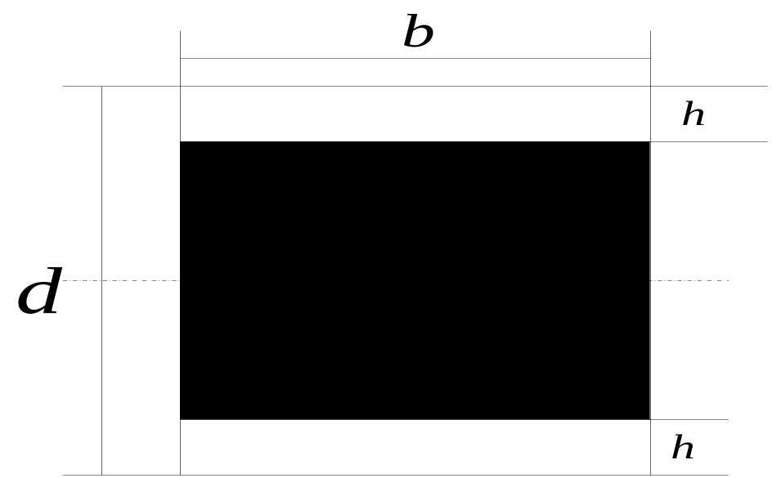
Case 1: Rectangular Section
In an elastic range, we have :
Elastoplastic beam is shown in this figure:

Slide 13
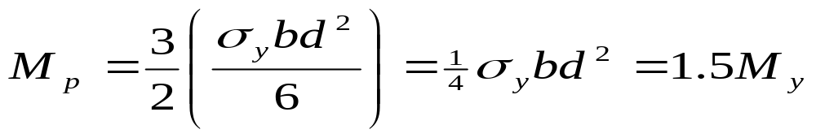
The total moment of resistance is given by:
When h becomes equal to d/2, the stress distribution is as shown in (c) and the highest value of bending moment is reached. This gives:

Slide 14
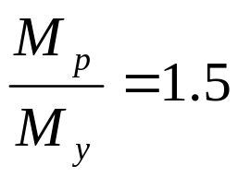
The ratio M_{p}\M_{y} is called the shape factor S, since it depends only on the shape of the cross-section, i.e. for a rectangular section,
Example 1: A steel bar of rectangular section 72 mm by 30 mm is used as a simply supported beam on a span of l.2 m and loaded at mid-span. If the yield stress is 280 N/mm² and the long edges of the section are vertical, find the load when yielding first occurs.
Assuming that a further increase in load causes yielding to spread inwards towards the neutral axis, with the stress in the yielded part remaining at 280 N/mm², find the load required to cause yielding for a depth of 12 mm at the top and bottom of the section at mid-span, and find the length of beam over which yielding has occurred.

Slide 15
Solution
If W_{y} is the load at first yield, then:
Under a higher load W, the central section of the beam is in a partially plastic state, the stress distribution being similar to Fig. 12.2(b), the outer 12 mm on each side of the neutral axis being under constant stress of 280 N/mm² with no drop of stress at yield. The moment of resistance calculated from the stress diagram is

Slide 16
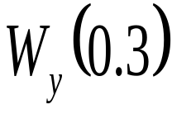
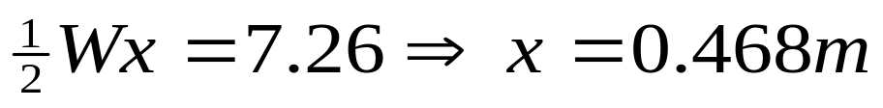

At first yield the moment of resistance is that is 7.26kN and if this occurs at a distance x from ether end under the central load W, then
The length of the beam over which yielding occurs is

Slide 17
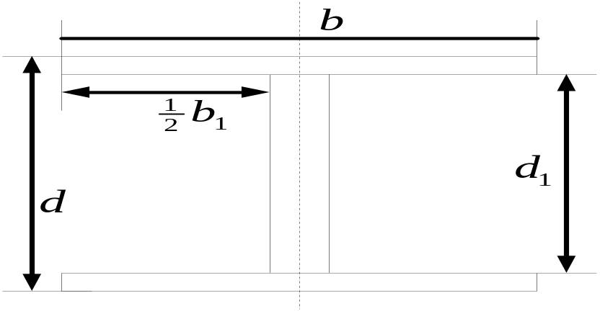
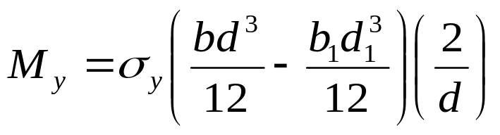
Case 2: I-Section
: I-section beam
Consider an I-beam when yielding is about to occur at the extreme fibre, we have :

Slide 18
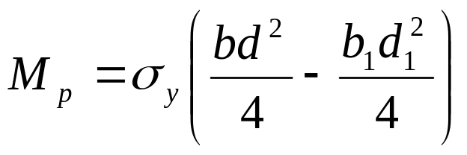
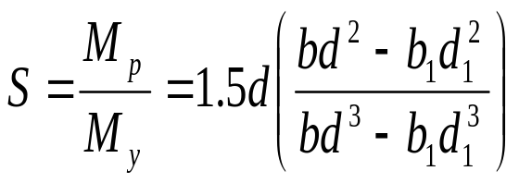
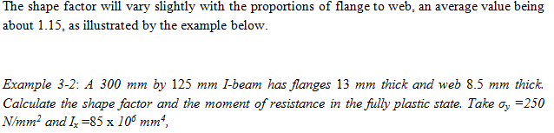
In a fully plastic condition, we have
The shape factor is

Slide 19

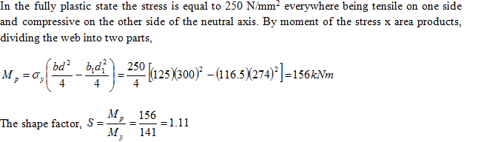
Solution

Slide 20
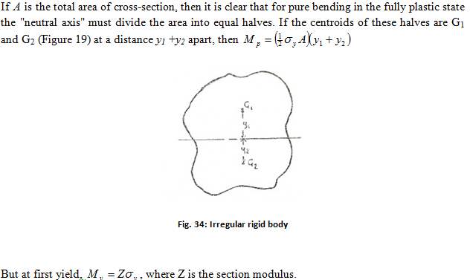
Case 3: General

Slide 21
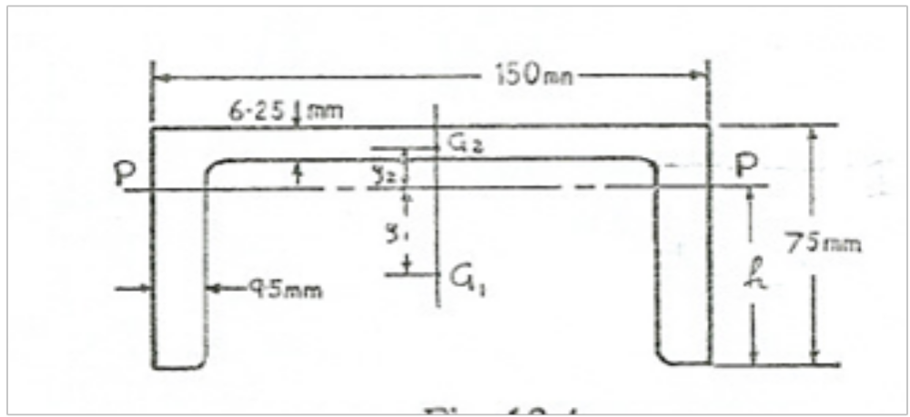

Slide 22
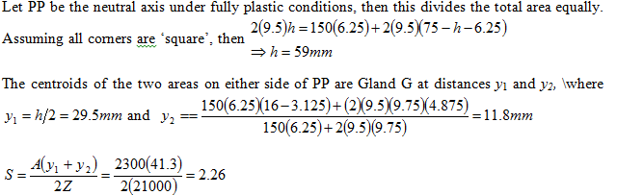

Slide 23
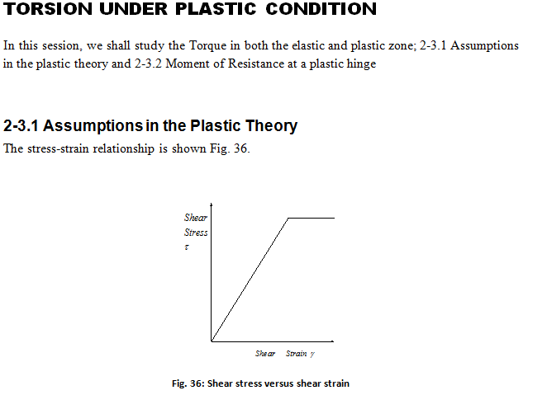

Slide 24
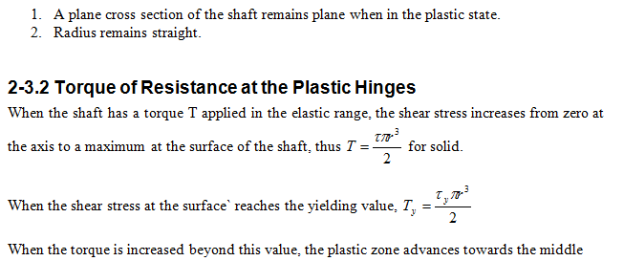

Slide 25
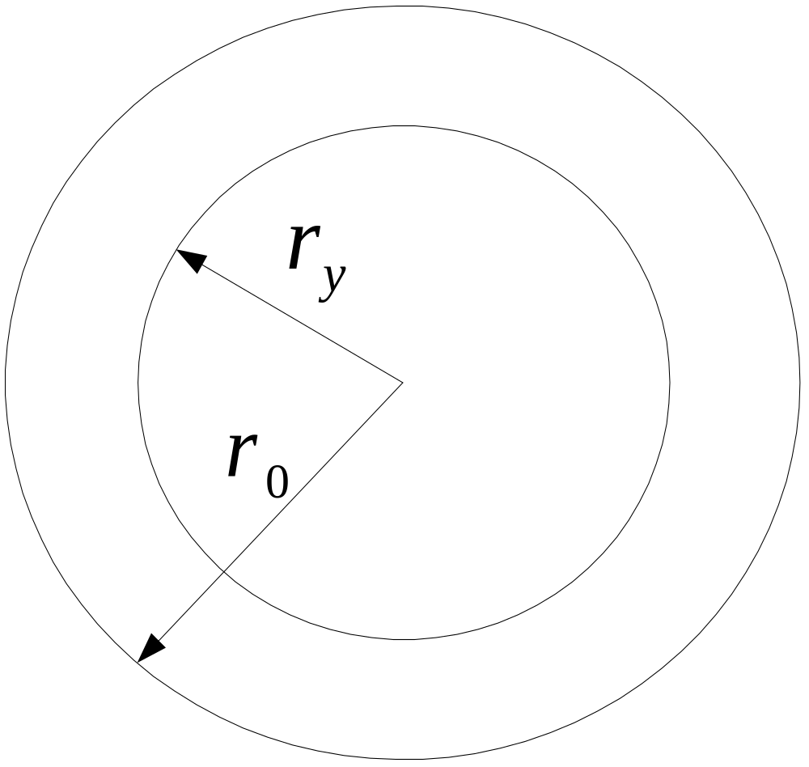

Slide 26
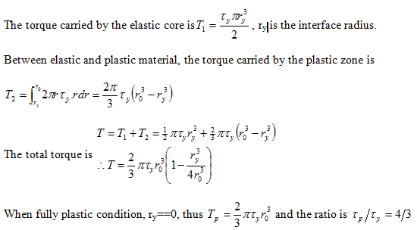

Slide 27
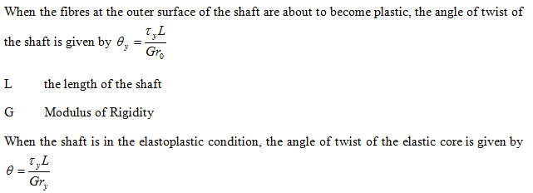

Slide 28
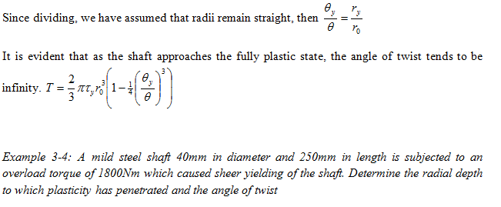

Slide 29
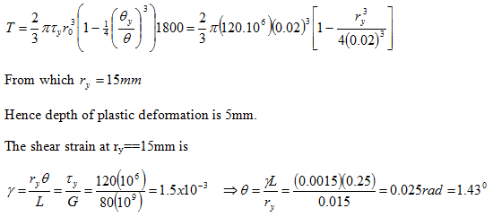
Solution

Slide 30


Slide 31
Review Question
Derive the shape factor for the general case
Derive the shape factor for I-section beam under bending load

Slide 32
Unit Assignments 3
A hollow shaft has external and internal diameters of 32 mm and 14 mm respectively, and is 750 mm long. The shaft is subjected to a torque which is increased to initiate plastic deformation in the shaft. The torque is further increased to cause the plastic to advance 3 mm radially into the shaft material. Calculate the following:
  The torque that initiated the plastic deformation
  The final torque
  The angle of twist on the surface of the shaft
Given G==85, 000 N/mm² and τ_{y}==120 N/mm².

